Slide 1
Module 2: Network Threats
Networking Security v1.0
(NETSEC)
Notes:
Networking Security (NETSEC) Module 2: Network Threats

Slide 2
Module Objectives
Module Title: Network Threats
Module Objective: Explain the various types of threats and attacks.
Topic Title | Topic Objective
Who is Attacking Our Network? | Explain how network threats have evoloved.
Threat Actor Tools | Describe the various types of attack tools used by Threat Actors.
Malware | Describe types of malware.
Common Network Attacks - Reconnaissance, Access, and Social Engineering | Explain reconnaissance, access, and social engineering network attacks.
Network Attacks - Denial of Service, Buffer Overflows, and Evasion Configurations | Explain Denial of Service, buffer overflow, and evasion attacks.
Notes:
2
2 – Basic Switch and End Device Configuration
2.0.2 – What will I learn to do in the module?

Slide 3
2.1 Who is Attacking Our Network?
Notes:
2: Network Threats 2.1: Who is Attacking Our Network?

Slide 4
Who is Attacking Our Network?
Threat, Vulnerability, and Risk
To understand network security, it is important to understand the terms threat, vulnerability, attack surface, exploit, and risk. Four common ways to manage risk are listed below.
Risk Management Strategy | Explanation
Risk acceptance | This is when the cost of risk management options outweighs the cost of the risk itself. The risk is accepted, and no action is taken.
Risk avoidance | This means avoiding any exposure to the risk by eliminating the activity or device that presents the risk. By eliminating an activity to avoid risk, any benefits that are possible from the activity are also lost.
Risk reduction | This reduces exposure to risk or reduces the impact of risk by taking action to decrease the risk. It is the most commonly used risk mitigation strategy. This strategy requires careful evaluation of the costs of loss, the mitigation strategy, and the benefits gained from the operation or activity that is at risk.
Risk transfer | Some (or all) of the risk is transferred to a willing third party such as an insurance company.
Notes:
2: Network Threats 2.1: Who is Attacking Our Network? 2.1.1: Threat, Vulnerability, and Risk

Slide 5
Who is Attacking Our Network?
Hacker vs. Threat Actor
As we know, “hacker” is a common term used to describe a threat actor. The term “hacker” has a variety of meanings, as follows:
A clever programmer capable of developing new programs and coding changes to existing programs to make them more efficient.
A network professional that uses sophisticated programming skills to ensure that networks are not vulnerable to attack.
A person who tries to gain unauthorized access to devices on the internet.
An individual who runs programs to prevent or slow network access to many users, or to corrupt or destroy data on servers.
You may see references to white hat, gray hat, and black hat hackers.
Notes:
2: Network Threats 2.1: Who is Attacking Our Network? 2.1.2: Hacker vs. Threat Actor

Slide 6
Who is Attacking Our Network?
Evolution of Threat Actors
Since hacking started in the 1960s with phone freaking, or phreaking, it has evolved to include many types of threat actors.
Threat Actor | Explanation
Script Kiddies | Script kiddies emerged in the 1990s. They are teenagers or inexperienced threat actors running existing scripts, tools, and exploits, to cause harm, but typically not for profit.
Vulnerability Brokers | Vulnerability brokers are grey hat hackers who attempt to discover exploits and report them to vendors, sometimes for prizes or rewards.
Hacktivists | Hacktivists are grey hat hackers who rally and protest against different political and social ideas.
Cybercriminals | Cybercriminal is a term for black hat hackers who are either self-employed or working for large cybercrime organizations.
State- Sponsored | State-Sponsored hackers are threat actors who steal government secrets, gather intelligence, and sabotage networks of foreign governments, terrorist groups, and corporations.
Notes:
2: Network Threats 2.1: Who is Attacking Our Network? 2.1.3: Evolution of Threat Actors

Slide 7

Who is Attacking Our Network?
Cybercriminals
Cybercriminals are threat actors who are motivated to make money using any means necessary.
While some cybercriminals work independently, they are more often financed and sponsored by criminal organizations.
It is estimated that globally, cybercriminals steal billions of dollars from consumers and businesses every year.
Notes:
2: Network Threats 2.1: Who is Attacking Our Network? 2.1.4: Cybercriminals

Slide 8
Who is Attacking Our Network?
Cybersecurity Tasks
Organizations must act to protect their assets, users, and customers. They must develop and practice cybersecurity tasks, including the following:
Use a trustworthy IT vendor
Keep security software up-to-date
Perform regular penetration tests
Back up to cloud and hard disk
Periodically change WIFI password
Keep security policy up-to-date
Enforce use of strong passwords
Use two factor authentication
Notes:
2: Network Threats 2.1: Who is Attacking Our Network? 2.1.5: Cybersecurity Tasks

Slide 9
Who is Attacking Our Network?
Cyber Threat Indicators
Many network attacks can be prevented by sharing information about indicators of compromise (IOC). Each attack has unique, identifiable attributes. Indicators of compromise are the evidence that an attack has occurred.
IOCs can be features that identify the following:
malware files
IP addresses of servers that are used in attacks
filenames
characteristic changes made to end system software
Indicators of attack (IOA) focus more on the motivation behind an attack and the potential means by which threat actors have, or will, compromise vulnerabilities to gain access to assets. IOAs are concerned with the strategies that are used by attackers.
Notes:
2: Network Threats 2.1: Who is Attacking Our Network? 2.1.6: Cyber Threat Indicators

Slide 10
Who is Attacking Our Network?
Threat Sharing and Building Cybersecurity Awareness
The US Cybersecurity Infrastructure and Security Agency (CISA) uses a system called Automated Indicator Sharing (AIS). AIS enables the sharing of attack indicators between the US government and the private sector as soon as threats are verified. CISA offers many resources that help to limit the size of the United States attack surface.
The CISA and the National Cyber Security Alliance (NCSA) promote cybersecurity to all users. For example, they have an annual campaign in every October called “National Cybersecurity Awareness Month” (NCSAM).
The European Union Agency for Cybersecurity (ENISA) delivers advice and solutions for the cybersecurity challenges of the EU member states.
Notes:
2: Network Threats 2.1: Who is Attacking Our Network? 2.1.7: Threat Sharing and Building Cybersecurity Awareness
2.1.8: Check Your Understanding - What Color is my Hat?

Slide 11
2.2 Threat Actor Tools
Notes:
2: Network Threats 2.2: Threat Actor Tools

Slide 12
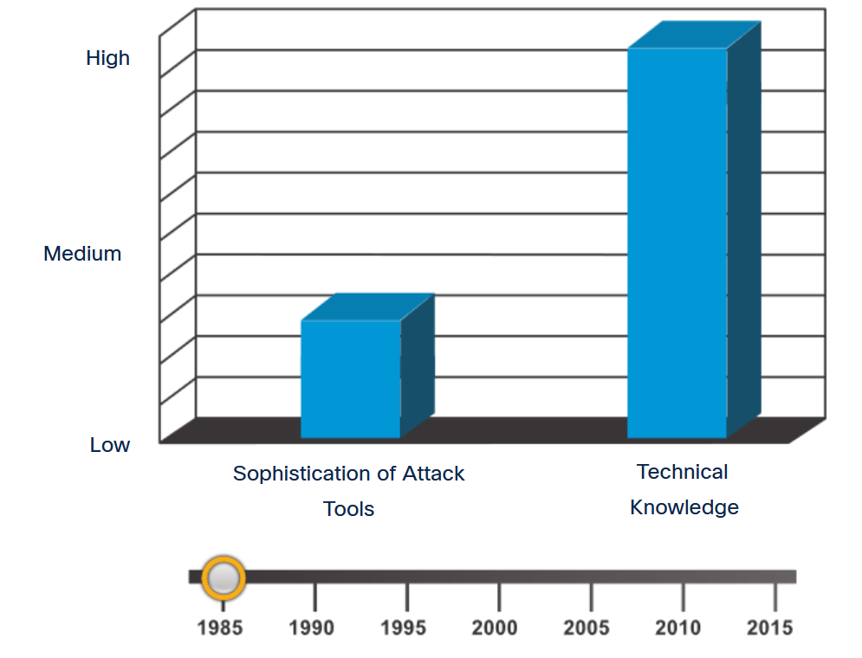
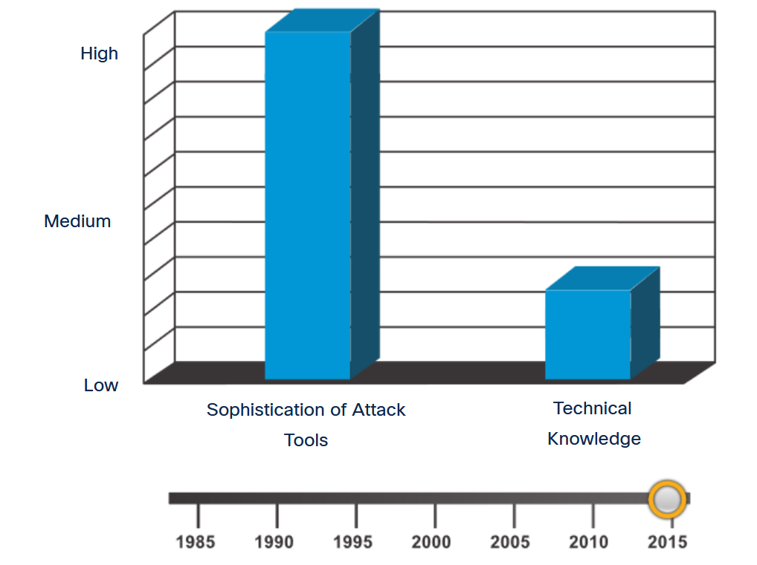
Threat Actor Tools
Introduction of Attack Tools
To exploit a vulnerability, a threat actor must have a technique or tool. Over the years, attack tools have become more sophisticated, and highly automated. These new tools require less technical knowledge to implement.
Notes:
2: Network Threats 2.2: Threat Actor Tools 2.2.1: Introduction of Attack Tools

Slide 13
Threat Actor Tools
Evolution of Security Tools
Ethical hacking uses many different types of tools to test the network and end devices. To validate the security of a network and its systems, many network penetration testing tools have been developed. However, many of these tools can also be used by threat actors for exploitation.
Categories of Tools | Description
password crackers | Passwords are the most vulnerable security threat. Password cracking tools are often referred to as password recovery tools and can be used to crack or recover the password. Password crackers repeatedly make guesses in order to crack the password and access the system. Examples of password cracking tools include John the Ripper, Ophcrack, L0phtCrack, THC Hydra, RainbowCrack, and Medusa.
wireless hacking tools | Wireless networks are more susceptible to network security threats. Wireless hacking tools are used to intentionally hack into a wireless network to detect security vulnerabilities. Examples of wireless hacking tools include Aircrack-ng, Kismet, InSSIDer, KisMAC, Firesheep, and NetStumbler.
network scanning and hacking tools | Network scanning tools are used to probe network devices, servers, and hosts for open TCP or UDP ports. Examples of scanning tools include Nmap, SuperScan, Angry IP Scanner, and NetScanTools.
packet crafting tools | Packet crafting tools are used to probe and test a firewall’s robustness using specially crafted forged packets. Examples of such tools include Hping, Scapy, Socat, Yersinia, Netcat, Nping, and Nemesis.
packet sniffers | Packet sniffer tools are used to capture and analyze packets within traditional Ethernet LANs or WLANs. Tools include Wireshark, Tcpdump, Ettercap, Dsniff, EtherApe, Paros, Fiddler, Ratproxy, and SSLstrip.
rootkit detectors | A rootkit detector is a directory and file integrity checker used by white hat hackers to detect installed root kits. Example tools include AIDE, Netfilter, and PF: OpenBSD Packet Filter.
Notes:
2: Network Threats 2.2: Threat Actor Tools 2.2.2: Evolution of Security Tools

Slide 14
Threat Actor Tools
Evolution of Security Tools (Cont.)
Categories of Tools | Description
fuzzers | Fuzzers are tools used by threat actors when attempting to discover a computer system’s security vulnerabilities. Examples of fuzzers include Skipfish, Wapiti, and W3af.
forensic tools | White hat hackers use forensic tools to sniff out any trace of evidence existing in a particular computer system. Example of tools include Sleuth Kit, Helix, Maltego, and Encase.
debuggers | Debugger tools are used by black hat hackers to reverse engineer binary files when writing exploits. They are also used by white hat hackers when analyzing malware. Debugging tools include GDB, WinDbg, IDA Pro, and Immunity Debugger.
hacking operating systems | Hacking operating systems are specially designed operating systems preloaded with tools and technologies optimized for hacking. Examples of specially designed hacking operating systems include Kali Linux, SELinux, Knoppix, Parrot OS, and BackBox Linux.
encryption tools | These tools safeguard the contents of an organization’s data when it is stored or transmitted. Encryption tools use algorithm schemes to encode the data to prevent unauthorized access to the data. Examples of these tools include VeraCrypt, CipherShed, Open SSH, OpenSSL, OpenVPN, and Stunnel.
vulnerability exploitation tools | These tools identify whether a remote host is vulnerable to a security attack. Examples of vulnerability exploitation tools include Metasploit, Core Impact, Sqlmap, Social Engineer Tool Kit, and Netsparker.
vulnerability scanners | These tools scan a network or system to identify open ports. They can also be used to scan for known vulnerabilities and scan VMs, BYOD devices, and client databases. Examples of these tools include Nipper, Securia PSI, Core Impact, Nessus, SAINT, and Open VAS.
Notes:
2: Network Threats 2.2: Threat Actor Tools 2.2.2: Evolution of Security Tools (Cont.)

Slide 15
Threat Actor Tools
Categories of Attacks
Category of Attack | Description
eavesdropping attack | An eavesdropping attack is when a threat actor captures and listens to network traffic. This attack is also referred to as sniffing or snooping.
data modification attack | Data modification attacks occur when a threat actor has captured enterprise traffic and has altered the data in the packets without the knowledge of the sender or receiver.
IP address spoofing attack | An IP address spoofing attack is when a threat actor constructs an IP packet that appears to originate from a valid address inside the corporate intranet.
password-based attacks | Password-based attacks occur when a threat actor obtains the credentials for a valid user account. Threat actors then use that account to obtain lists of other users and network information. They could also change server and network configurations, and modify, reroute, or delete data.
denial-of-service (DoS) attack | A DoS attack prevents normal use of a computer or network by valid users. After gaining access to a network, a DoS attack can crash applications or network services. A DoS attack can also flood a computer or the entire network with traffic until a shutdown occurs because of the overload. A DoS attack can also block traffic, which results in a loss of access to network resources by authorized users.
Notes:
2: Network Threats 2.2: Threat Actor Tools 2.2.3: Categories of Attacks
2.2.4: Check Your Understanding - Classify Cyber Attacks

Slide 16
Threat Actor Tools
Categories of Attacks (Cont.)
Category of Attack | Description
man-in-the-middle attack (MiTM) | A MiTM attack occurs when threat actors have positioned themselves between a source and destination. They can now actively monitor, capture, and control the communication transparently.
Compromised key attack | A compromised key attack occurs when a threat actor obtains a secret key. This is referred to as a compromised key. A compromised key can be used to gain access to a secured communication without the sender or receiver being aware of the attack.
sniffer attack | A sniffer is an application or device that can read, monitor, and capture network data exchanges and read network packets. If the packets are not encrypted, a sniffer provides a full view of the data inside the packet. Even encapsulated (tunneled) packets can be broken open and read unless they are encrypted, and the threat actor does not have access to the key.
Notes:
2: Network Threats 2.2: Threat Actor Tools 2.2.3: Categories of Attacks (Cont.)
2.2.4: Check Your Understanding - Classify Cyber Attacks

Slide 17
2.3 Malware
Notes:
2: Network Threats 2.3: Malware

Slide 18
Malware
Types of Malware
Malware is short for malicious software or malicious code. It is code or software that is specifically designed to damage, disrupt, steal, or generally inflict some other “bad” or illegitimate action on data, hosts, or networks.
End devices are especially prone to malware attacks.
Three most common types of malware are:
virus
worm
Trojan horse
Notes:
2: Network Threats 2.3: Malware 2.3.1: Types of Malware

Slide 19
Malware
Viruses
A virus is a type of malware that spreads by inserting a copy of itself into another program. After the program is run, viruses then spread from one computer to another, infecting the computers. Most viruses require human help to spread.
A simple virus may install itself at the first line of code in an executable file. When activated, the virus might check the disk for other executables so that it can infect all the files it has not yet infected.
Viruses can also be programmed to mutate to avoid detection.
Most viruses are now spread by USB memory drives, CDs, DVDs, network shares, and email.
Notes:
2: Network Threats 2.3: Malware 2.3.2: Viruses

Slide 20
Malware
Trojan Horses
Trojan horse malware is software that appears to be legitimate, but it contains malicious code which exploits the privileges of the user who runs it.
Often, Trojans are found attached to online games. Users are commonly tricked into loading and executing the Trojan horse on their systems. While playing the game, the user will not notice a problem. In the background, the Trojan horse has been installed on the user’s system. The malicious code from the Trojan horse continues operating even after the game has been closed.
The Trojan horse concept is flexible. It can cause immediate damage, provide remote access to the system, or access through a back door. It can also perform actions as instructed remotely, such as "send me the password file once per week."
Notes:
2: Network Threats 2.3: Malware 2.3.3: Trojan Horses

Slide 21
Malware
Trojan Horse Classification
Trojan horses are usually classified according to the damage that they cause, or the manner in which they breach a system, as shown in the table.
Type of Trojan Horse | Description
Remote-access | Enables unauthorized remote access.
Data-sending | Provides the threat actor with sensitive data, such as passwords.
Destructive | Corrupts or deletes files.
Proxy | Uses the victim's computer as the source device to launch attacks and perform other illegal activities.
FTP | Enables unauthorized file transfer services on end devices.
Security software disabler | Stops antivirus programs or firewalls from functioning.
Denial of Service (DoS) | Slows or halts network activity.
Keylogger | Actively attempts to steal confidential information, such as credit card numbers, by recording keystrokes that have been entered into a web form.
Notes:
2: Network Threats 2.3: Malware 2.3.4: Trojan Horse Classification

Slide 22
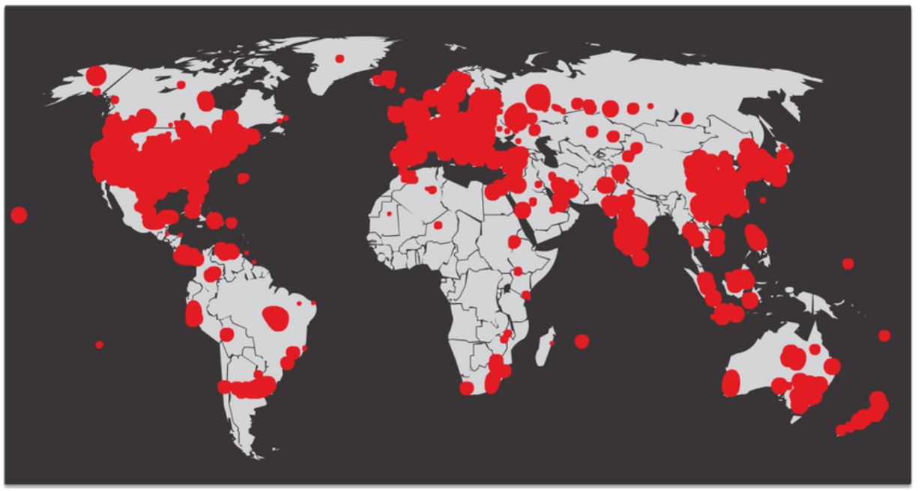
Malware
Worms
Computer worms are like viruses because they replicate and can cause the same type of damage. Specifically, worms replicate themselves by independently exploiting vulnerabilities in networks. Worms can slow down networks as they spread from system to system.
SQL Slammer, known as the worm that ate the internet, was a denial of service (DoS) attack that exploited a buffer overflow bug in Microsoft’s SQL Server. At its peak, the number of infected servers doubled in size every 8.5 seconds. It infected 250,000+ hosts within 30 minutes, as shown in the figure.
Notes:
2: Network Threats 2.3: Malware 2.3.5: Worms

Slide 23
Malware
Worm Components
Most worm attacks consist of three components:
Enabling vulnerability - A worm installs itself using an exploit mechanism, such as an email attachment, an executable file, or a Trojan horse, on a vulnerable system.
Propagation mechanism - After gaining access to a device, the worm replicates itself and locates new targets.
Payload - Any malicious code that results in some action is a payload. Most often this is used to create a backdoor that allows a threat actor access to the infected host or to create a DoS attack.
Notes:
2: Network Threats 2.3: Malware 2.3.6: Worm Components

Slide 24
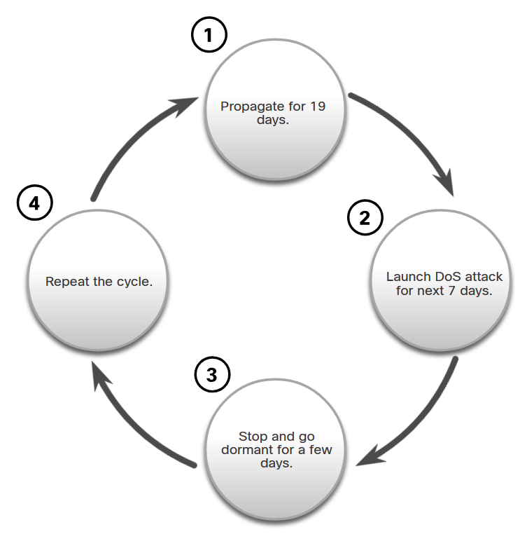
Malware
Worm Components (Cont.)
The propagation technique used by the Code Red worm is shown in the figure.
Notes:
2: Network Threats 2.3: Malware 2.3.6: Worm Components (Cont.)

Slide 25
Malware
Ransomware
Currently, the most dominant malware is ransomware.
Ransomware is malware that denies access to the infected computer system or its data. The cybercriminals then demand payment to release the computer system.
Ransomware has evolved to become the most profitable malware type in history.
There are dozens of ransomware variants.
Ransomware frequently uses an encryption algorithm to encrypt system files and data.
Payments are typically paid in Bitcoin because users of bitcoin can remain anonymous.
Email and malicious advertising, also known as malvertising, are vectors for ransomware campaigns.
Social engineering is also used.
Notes:
2: Network Threats 2.3: Malware 2.3.7: Ransomware

Slide 26
Malware
Other Malware
These are some examples of the varieties of modern malware:
Type of Malware | Description
Spyware | Used to gather information about a user and send the information to another entity without the user’s consent. Spyware can be a system monitor, Trojan horse, Adware, tracking cookies, and key loggers.
Adware | Displays annoying pop-ups to generate revenue for its author. The malware may analyze user interests by tracking the websites visited. It can then send pop-up advertising pertinent to those sites.
Scareware | Includes scam software which uses social engineering to shock or induce anxiety by creating the perception of a threat. It is generally directed at an unsuspecting user and attempts to persuade the user to infect a computer by taking action to address the bogus threat.
Phishing | Attempts to convince people to divulge sensitive information. Examples include receiving an email from their bank asking users to divulge their account and PIN numbers.
Rootkits | Installed on a compromised system. After it is installed, it continues to hide its intrusion and provide privileged access to the threat actor.
Notes:
2: Network Threats 2.3: Malware 2.3.8: Other Malware

Slide 27
Malware
Common Malware Behaviors
Computers infected with malware often exhibit one or more of the following symptoms:
Appearance of strange files, programs, or desktop icons
Antivirus and firewall programs are turning off or reconfiguring settings
Computer screen is freezing or system is crashing
Emails are spontaneously being sent to your contact list without your knowledge
Files have been modified or deleted
Increased CPU and/or memory usage
Problems connecting to networks
Slow computer or web browser speeds
Unknown processes or services running
Unknown TCP or UDP ports open
Connections are made to hosts on the internet without user action
Other strange computer behavior
Notes:
2: Network Threats 2.3: Malware 2.3.9: Common Malware Behaviors
2.3.10: Check Your Understanding - Malware

Slide 28
2.4 Common Network Attacks - Reconnaissance, Access, and Social Engineering
Notes:
2: Network Threats 2.4: Common Network Attacks - Reconnaissance, Access, and Social Engineering

Slide 29
Common Network Attacks - Reconnaissance, Access, and Social Engineering
Types of Network Attacks
To mitigate attacks, it is useful to first categorize the various types of attacks. By categorizing network attacks, it is possible to address types of attacks rather than individual attacks.
Although there is no standardized way of categorizing network attacks, the method used in this course classifies attacks in three major categories.
Reconnaissance Attacks
Access Attacks
DoS Attacks
Notes:
2: Network Threats 2.4: Common Network Attacks - Reconnaissance, Access, and Social Engineering 2.4.1: Types of Network Attacks

Slide 30
Common Network Attacks - Reconnaissance, Access, and Social Engineering
Reconnaissance Attacks
Reconnaissance is information gathering. Threat actors use reconnaissance (or recon) attacks to do unauthorized discovery and mapping of systems, services, or vulnerabilities. Recon attacks precede access attacks or DoS attacks. Some of the techniques used by malicious threat actors to conduct reconnaissance attacks are described in the table.
Technique | Description
Perform an information query of a target | The threat actor is looking for initial information about a target. Various tools can be used, including the Google search, organizations website, whois, and more.
Initiate a ping sweep of the target network | The information query usually reveals the target’s network address. The threat actor can now initiate a ping sweep to determine which IP addresses are active.
Initiate a port scan of active IP addresses | This is used to determine which ports or services are available. Examples of port scanners include Nmap, SuperScan, Angry IP Scanner, and NetScanTools.
Run vulnerability scanners | This is to query the identified ports to determine the type and version of the application and operating system that is running on the host. Examples of tools include Nipper, Secuna PSI, Core Impact, Nessus v6, SAINT, and Open VAS.
Run exploitation tools | The threat actor now attempts to discover vulnerable services that can be exploited. A variety of vulnerability exploitation tools exist including Metasploit, Core Impact, Sqlmap, Social Engineer Toolkit, and Netsparker.
Notes:
2: Network Threats 2.4: Common Network Attacks - Reconnaissance, Access, and Social Engineering 2.4.2: Reconnaissance Attacks

Slide 31
Common Network Attacks - Reconnaissance, Access, and Social Engineering
Video - Reconnaissance Attacks
This video will explain the following techniques used in a reconnaissance attack:
Perform an information query on a target
Initiate a ping sweep of the target network
Initiate a port scan of active ip addresses
Run vulnerability scanners
Run exploitation tools
Notes:
2: Network Threats 2.4: Common Network Attacks - Reconnaissance, Access, and Social Engineering 2.4.3: Video - Reconnaissance Attacks

Slide 32
Common Network Attacks - Reconnaissance, Access, and Social Engineering
Access Attacks
Access attacks exploit known vulnerabilities in authentication services, FTP services, and web services. The purpose of this type of attack is to gain entry to web accounts, confidential databases, and other sensitive information.
Technique | Description
Password Attacks | In a password attack, the threat actor attempts to discover critical system passwords using various methods.
Spoofing Attacks | In spoofing attacks, the threat actor’s device attempts to pose as another device by falsifying data. Common spoofing attacks include IP spoofing, MAC spoofing, and DHCP spoofing.
Trust Exploitation | In a trust exploitation attack, a threat actor uses unauthorized privileges to gain access to a system, possibly compromising the target.
Port redirection | In a port redirection attack, a threat actor uses a compromised system as a base for attacks against other targets.
Man-in-the-Middle | In a man-in-the-middle attack, the threat actor is positioned in between two legitimate entities in order to read or modify the data that passes between the two parties.
Buffer Overflow Attack | In a buffer overflow attack, the threat actor exploits the buffer memory and overwhelms it with unexpected values. This usually renders the system inoperable, resulting in a DoS attack.
Notes:
2: Network Threats 2.4: Common Network Attacks - Reconnaissance, Access, and Social Engineering 2.4.4: Access Attacks

Slide 33
Common Network Attacks - Reconnaissance, Access, and Social Engineering
Video - Access and Social Engineering Attacks
This video will cover the following:
Techniques used in access attacks (password attacks, spoofing attacks, trust exploitations, port redirections, man-in-the-middle attacks, buffer overflow attacks)
Techniques used in social engineering attacks (pretexting, phishing, spear phishing, spam, something for something, baiting, impersonation, tailgating, shoulder surfing, dumpster diving)
Notes:
2: Network Threats 2.4: Common Network Attacks - Reconnaissance, Access, and Social Engineering 2.4.5: Video - Access and Social Engineering Attacks

Slide 34
Common Network Attacks - Reconnaissance, Access, and Social Engineering
Social Engineering Attacks
Social engineering is an access attack that attempts to manipulate individuals into performing actions or divulging confidential information. Information about social engineering techniques is shown in the table.
Social Engineering Attack | Description
Pretexting | A threat actor pretends to need personal or financial data to confirm the identity of the recipient.
Phishing | A threat actor sends fraudulent email which is disguised as being from a legitimate, trusted source to trick the recipient into installing malware on their device, or to share personal or financial information.
Spear phishing | A threat actor creates a targeted phishing attack tailored for a specific individual or organization.
Spam | Also known as junk mail, this is unsolicited email which often contains harmful links, malware, or deceptive content.
Something for Something | Sometimes called “Quid pro quo”, this is when a threat actor requests personal information from a party in exchange for something such as a gift.
Baiting | A threat actor leaves a malware-infected flash drive in a public location. A victim finds the drive and unsuspectingly inserts it into their laptop, unintentionally installing malware.
Impersonation | In this type of attack, a threat actor pretends to be someone else to gain the trust of a victim.
Notes:
2: Network Threats 2.4: Common Network Attacks - Reconnaissance, Access, and Social Engineering 2.4.6: Social Engineering Attacks

Slide 35
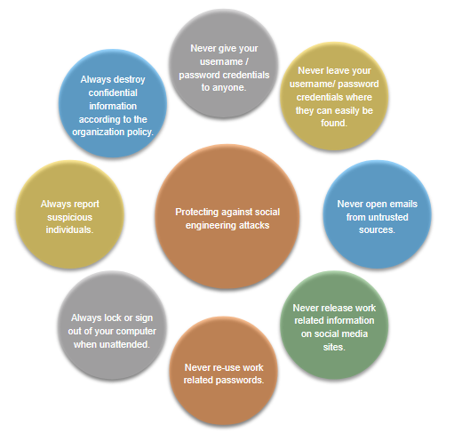
Common Network Attacks - Reconnaissance, Access, and Social Engineering
Social Engineering Attacks (Cont.)
Social Engineering Attack | Description
Tailgating | This is where a threat actor quickly follows an authorized person into a secure location to gain access to a secure area.
Shoulder surfing | This is where a threat actor inconspicuously looks over someone’s shoulder to steal their passwords or other information.
Dumpster diving | This is where a threat actor rummages through trash bins to discover confidential documents.
Notes:
2: Network Threats 2.4: Common Network Attacks - Reconnaissance, Access, and Social Engineering 2.4.6: Social Engineering Attacks (Cont.)

Slide 36
Common Network Attacks - Reconnaissance, Access, and Social Engineering
Strengthening the Weakest Link
Cybersecurity is only as strong as its weakest link. Because computers and other internet-connected devices have become an essential part of our lives, they no longer seem new or different.
The weakest link in cybersecurity can be the personnel within an organization, and social engineering is a major security threat. Because of this, one of the most effective security measures that an organization can take is to train its personnel and create a “security-aware culture.”
Notes:
2: Network Threats 2.4: Common Network Attacks - Reconnaissance, Access, and Social Engineering 2.4.7: Strengthening the Weakest Link

Slide 37
Common Network Attacks - Reconnaissance, Access, and Social Engineering
Lab - Social Engineering
In this lab, you will research examples of social engineering and identify ways to recognize and prevent it.
Notes:
2: Network Threats 2.4: Common Network Attacks - Reconnaissance, Access, and Social Engineering 2.4.8: Lab - Social Engineering

Slide 38
2.5 Network Attacks - Denial of Service, Buffer Overflows, and Evasion
Notes:
2: Network Threats 2.5: Network Attacks - Denial of Service, Buffer Overflows, and Evasion

Slide 39
Network Attacks - Denial of Service, Buffer Overflows, and Evasion
Video - Denial of Service Attacks
This video will cover the following:
Techniques used in Denial-of-Service attacks (overwhelming quantity of traffic, maliciously formatted packets)
Techniques used in Distributed Denial-of-Service attacks (zombies)
Notes:
2: Network Threats 2.5: Network Attacks - Denial of Service, Buffer Overflows, and Evasion 2.5.1: Video - Denial of Service Attacks

Slide 40
Network Attacks - Denial of Service, Buffer Overflows, and Evasion
DoS and DDoS Attacks
A Denial of Service (DoS) attack creates some sort of interruption of network services to users, devices, or applications. There are two major types of DoS attacks:
Overwhelming Quantity of Traffic
Maliciously Formatted Packets
A Distributed DoS Attack (DDoS) is like a DoS attack, but it originates from multiple, coordinated sources.
Notes:
2: Network Threats 2.5: Network Attacks - Denial of Service, Buffer Overflows, and Evasion 2.5.2: DoS and DDoS Attacks

Slide 41
Network Attacks - Denial of Service, Buffer Overflows, and Evasion
Components of DDoS Attacks
If threat actors can compromise many hosts, they can perform a Distributed DoS Attack (DDoS). DDoS attacks are similar in intent to DoS attacks, except that a DDoS attack increases in magnitude because it originates from multiple, coordinated sources. The following terms are used to describe components of a DDoS attack:
Component | Description
zombies | This refers to a group of compromised hosts (i.e., agents). These hosts run malicious code referred to as robots (i.e., bots). The zombie malware continually attempts to self-propagate like a worm.
bots | Bots are malware that is designed to infect a host and communicate with a handler system. Bots can also log keystrokes, gather passwords, capture and analyze packets, and more.
botnet | This refers to a group of zombies that have been infected using self-propagating malware (i.e., bots) and are controlled by handlers.
handlers | This refers to a master command-and-control (CnC or C2) server controlling groups of zombies. The originator of a botnet can use Internet Relay Chat (IRC) or a web server on the C2 server to remotely control the zombies.
botmaster | This is the threat actor who is in control of the botnet and handlers.
Notes:
2: Network Threats 2.5: Network Attacks - Denial of Service, Buffer Overflows, and Evasion 2.5.3: Components of DDoS Attacks

Slide 42
Network Attacks - Denial of Service, Buffer Overflows, and Evasion
Video - Mirai Botnet
This video will demonstrate a DDoS attack using Mirai Botnet.
Notes:
2: Network Threats 2.5: Network Attacks - Denial of Service, Buffer Overflows, and Evasion 2.5.4: Video - Mirai Botnet

Slide 43
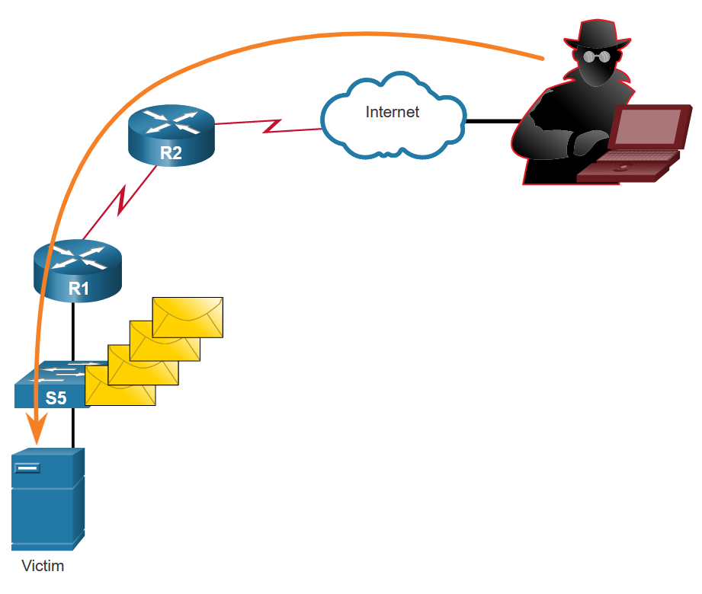
Network Attacks - Denial of Service, Buffer Overflows, and Evasion
Buffer Overflow Attack
The goal of a threat actor when using a buffer overflow DoS attack is to find a system memory-related flaw on a server and exploit it. Exploiting the buffer memory by overwhelming it with unexpected values usually renders the system inoperable, creating a DoS attack.
It is estimated that one third of malicious attacks are the result of buffer overflows.
Notes:
2: Network Threats 2.5: Network Attacks - Denial of Service, Buffer Overflows, and Evasion 2.5.5: Buffer Overflow Attack

Slide 44
Network Attacks - Denial of Service, Buffer Overflows, and Evasion
Evasion Methods
Some of the evasion methods used by threat actors include:
Evasion Method | Description
Encryption and tunneling | This evasion technique uses tunneling to hide, or encryption to scramble, malware files. This makes it difficult for many security detection techniques to detect and identify the malware. Tunneling can mean hiding stolen data inside of legitimate packets.
Resource exhaustion | This evasion technique makes the target host too busy to properly use security detection techniques.
Traffic fragmentation | This evasion technique splits a malicious payload into smaller packets to bypass network security detection. After the fragmented packets bypass the security detection system, the malware is reassembled and may begin sending sensitive data out of the network.
Protocol-level misinterpretation | This evasion technique occurs when network defenses do not properly handle features of a PDU like a checksum or TTL value. This can trick a firewall into ignoring packets that it should check.
Traffic substitution | In this evasion technique, the threat actor attempts to trick an IPS by obfuscating the data in the payload. This is done by encoding it in a different format. For example, the threat actor could use encoded traffic in Unicode instead of ASCII. The IPS does not recognize the true meaning of the data, but the target end system can read the data.
Notes:
2: Network Threats 2.5: Network Attacks - Denial of Service, Buffer Overflows, and Evasion 2.5.6: Evasion Methods

Slide 45
Network Attacks - Denial of Service, Buffer Overflows, and Evasion
Evasion Methods (Cont.)
Evasion Method | Description
Traffic insertion | Similar to traffic substitution, but the threat actor inserts extra bytes of data in a sequence of malicious data. The IPS rules miss the malicious data, accepting the full sequence of data.
Pivoting | This technique assumes that the threat actor has compromised an inside host and wants to expand their access further into the compromised network. An example is a threat actor who has gained access to the administrator password on a compromised host and is attempting to login to another host using the same credentials.
Rootkits | A rootkit is a complex attacker tool used by experienced threat actors. It integrates with the lowest levels of the operating system. When a program attempts to list files, processes, or network connections, the rootkit presents a sanitized version of the output, eliminating any incriminating output. The goal of the rootkit is to completely hide the activities of the attacker on the local system.
Proxies | Network traffic can be redirected through intermediate systems in order to hide the ultimate destination for stolen data. In this way, known command-and-control cannot be blocked by an enterprise because the proxy destination appears benign. Additionally, if data is being stolen, the destination for the stolen data can be distributed among many proxies, thus not drawing attention to the fact that a single unknown destination is serving as the destination for large amounts of network traffic.
Notes:
2: Network Threats 2.5: Network Attacks - Denial of Service, Buffer Overflows, and Evasion 2.5.6: Evasion Methods (Cont.)
2.5.7: Check Your Understanding - Identify the Types of Network Attacks

